Slide 1
Indoor localization
Mehrdad Dehdashti,
Guy Lifshitz,
Shams Methnani,
Lauren Campbell,
Andrey Paunov

Slide 2
What is it?
It is not GPS!
GPS uses satellite navigation system. Always works near the Earth’s surface! Accuracy rate 10 – 100m
Indoor locationing uses Wi-Fi, Bluetooth or special sensory

Slide 3
Why the interest?
Mobile devices – used widely
Augmented reality – interactive video games
Campus maps (www.campusguiden.no)
Guided tours of museums
Mall and airport maps
Targeted advertising
Already there:
Microsoft’s RADAR (signal strength map of a building)
Active Bat from AT&T (ultrasonic detectors)

Slide 4
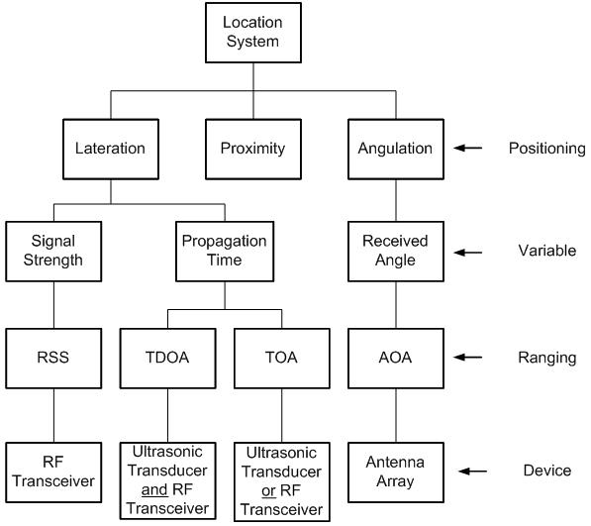
Classification of location tracking systems

Slide 5
Positioning aspect:
Proximity – Course grained (Rough estimation) of the target position
Angulation & Lateration – both use fine grained (precise estimations)
Variable aspect:
Received angle – between target and reference locations (angulation estimation)
Propagation time – signal transmission form transmitter to receiver (constant – used to find the distance between the target and the sensors)
Signal strength – measured at the receiver (signal strength inversely proportional to distance)

Slide 6
Ranging aspect:
Angle of arrival (AOA), time of arrival (TOA), time difference of arrival (TDOA), improvement over TOA, and received signal strength (RSS)
Device aspect:
Antenna array – measure angle of received signal, by comparing the phase difference of signal from different antennas
Radio frequency (RF) transceiver – measure the received power and provide to RSS

Slide 7
Algorithms
Hop – count Spreading
Triangulation Estimation
Trilateration Estimation

Slide 8
Indoor != Outdoor Locationing
 | Outdoor | Indoor
Path loss model | Linear | Affected by multi-path and shadowing
Accuracy | Easy to achieve but not necessary (wide space) | Difficult to achieve but important (small space)
Space | Wide and not limited | Small and mostly rectangular
Deployment | Random | Can be planned
Transmission power | Maximum to maintain Location/Quantity Indicator (LQI) | Adjusted to avoid interference
Height of reference nodes | Ground | Ceiling
Map | Global | Local
Table 1: Comparison of Indoor and Outdoor Location Tracking (Pu, 2009)

Slide 9
Advantages of using WSN for indoor locationing
Low power consumption
Inexpensive devices
No special equipment required
Software configurable and flexible
Wide radio coverage
Good processing ability
Sufficient I/O for sensing and actuating
WSN abundant set of resources

Slide 10
Disadvantages of using WSN for indoor locationing
Sensor size constraint
Limited in processing capability
Storage capacity
Communication bandwidth
Battery power supply

Slide 11
References
Bilton, 2012, Samsung, Nokia, and Qualcomm team up to improve indoor location technology http://venturebeat.com/2012/08/23/samsung-nokia-and-qualcomm-team-up-to-improve-indoor-location-technology/
Pu et al., Indoor Location Tracking using Received Signal Strength Indicator

